Slide 1
Introduction to Electricity & Ohm's Law
MSLETB - Electrical Instrumentation Phase 2

Slide 2
Module 1: Foundational Concepts
Session 1.1: Introduction & Atomic Theory

Slide 3
Why Are We Here?
The Importance of Electricity
Question: What is the one thing almost every trade on a modern job site depends on?
  Answer: Electricity.
From power tools for carpenters to control systems for plumbers and HVAC technicians, a solid understanding of electricity is essential for safety and success in any skilled trade.
Course Goal: To build your knowledge from the ground up, starting with the very basics, so you can work safely and competently.

Slide 4
The Building Block of Everything: The Atom
Everything in the universe—from the copper in a wire to the air we breathe—is made up of atoms.
An atom is the smallest particle of an element that still has the properties of that element.
To understand electricity, we must first understand the structure of the atom.

Slide 5
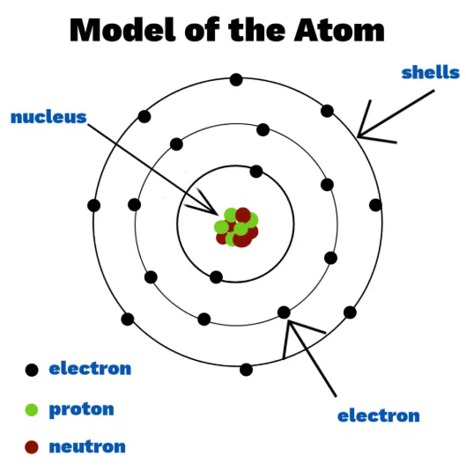
Inside the Atom
An atom has two main parts: the Nucleus and the orbiting Electrons.
The Nucleus (The Center)
  Protons: Have a POSITIVE (+) electrical charge.
  Neutrons: Have NO charge (they are neutral).
The Orbiting Particles
  Electrons: Have a NEGATIVE (-) electrical charge. They are very small and orbit the nucleus at high speed.
  Key Point: In a normal atom, the number of electrons (-) is equal to the number of protons (+). This makes the atom electrically neutral.

Slide 6
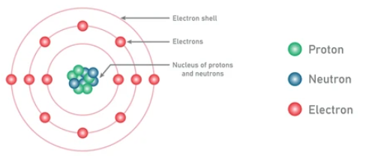
The Most Important Part: Electron Shells
Electrons don't just orbit randomly; they stay in specific paths called shells or energy levels.
Think of it like planets orbiting the sun in our solar system.
Each shell can only hold a certain number of electrons.
The shell furthest from the nucleus is the most important one for electricity.

Slide 7
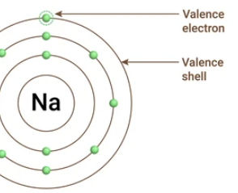
The Valence Shell - The Key to Electricity
The outermost shell of an atom is called the VALENCE SHELL.
The electrons in this shell are called valence electrons.
The flow of electricity is the flow of electrons.
How easily an electron can leave its valence shell determines if a material will be a good conductor of electricity or not.
If a valence electron can be easily "knocked out" of its shell, it can move freely and contribute to electric current.

Slide 8
Activity Time
Goal: To see the difference between an atom of a conductor and an atom of an insulator.
You will need:
Pen / Pencil
Paper
We will draw two different atoms:
Copper: A great electrical conductor.
Neon: A gas used in signs, which is an electrical insulator.

Slide 9
Activity: Draw a Conductor (Copper)
Copper Atom (Cu)
Protons: 29 (+)
Electrons: 29 (-)
Shell Structure:
1st Shell: 2 electrons
2nd Shell: 8 electrons
3rd Shell: 18 electrons
Valence Shell (4th): 1 electron
Draw this atom. Notice how lonely that one valence electron is. It's not held tightly and can easily be pushed out!

Slide 10
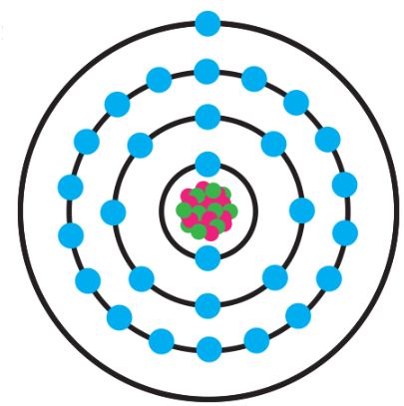
Activity: Draw a Conductor (Copper)
Copper Atom (Cu)
Protons: 29 (+)
Electrons: 29 (-)
Shell Structure:
1st Shell: 2 electrons
2nd Shell: 8 electrons
3rd Shell: 18 electrons
Valence Shell (4th): 1 electron
Draw this atom. Notice how lonely that one valence electron is. It's not held tightly and can easily be pushed out!

Slide 11
Activity: Draw an Insulator (Neon)
Neon Atom (Ne)
Protons: 10 (+)
Electrons: 10 (-)
Shell Structure:
1st Shell: 2 electrons
Valence Shell (2nd): 8 electrons
Draw this atom. The valence shell is full and stable (8 is a happy number for shells). These electrons are held very tightly and are not free to move.

Slide 12
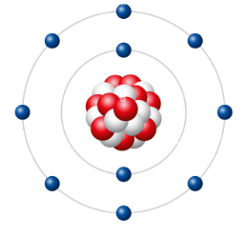
Activity: Draw an Insulator (Neon)
Neon Atom (Ne)
Protons: 10 (+)
Electrons: 10 (-)
Shell Structure:
1st Shell: 2 electrons
Valence Shell (2nd): 8 electrons
Draw this atom. The valence shell is full and stable (8 is a happy number for shells). These electrons are held very tightly and are not free to move.

Slide 13
Activity Debrief
What did we see?
Copper (Conductor):
  Has only 1 valence electron.
  This electron is far from the nucleus and weakly held.
  It requires very little energy to make it leave the atom and become a "free electron."
Neon (Insulator):
  Has 8 valence electrons.
  The valence shell is full and stable.
  It requires a huge amount of energy to remove an electron.
  Conclusion: The number of valence electrons is the key difference between conductors and insulators.
Notes:
The reason it takes very little energy to free that single valence electron in a copper atom comes down to two main factors:
Distance from the Nucleus: The valence shell is the furthest shell from the positive pull of the nucleus. According to Coulomb's Law, the force of attraction between positive and negative charges gets much weaker as they get further apart. That single electron is so far away that the nucleus has only a very weak grip on it.
Shielding Effect: The 28 electrons in the inner shells create a repulsive negative force that "shields" or screens the single valence electron from the full attractive pull of the 29 positive protons in the nucleus.
Think of it like the nucleus is a magnet. The valence electron is a tiny piece of metal held far away, with lots of other pieces of metal in between blocking the magnetic field. Because it's so far away and shielded, the magnetic pull is extremely weak, and it takes just a tiny nudge of energy to break it free. This is what makes copper an excellent conductor.
The reason it takes a huge amount of energy to remove an electron from an atom like Neon is due to atomic stability. Here’s a breakdown based on the concepts in your Canvas slides:
Full Valence Shell: As shown on Slide 10, a Neon atom has 8 electrons in its valence shell. In chemistry and physics, having a full outer shell is a very stable and "happy" state for an atom. The atom has no natural tendency to give up any of these electrons because doing so would break this perfect stability.
Strong Attraction: The 10 positive protons in the nucleus create a strong, balanced attractive force on the 10 negative electrons. Because the outer shell is perfectly full, the electrons are held very tightly and uniformly in place.
To remove an electron, you would have to supply enough energy to overcome this strong attraction and break apart that stable, full shell. This is fundamentally different from a conductor like copper, which has a single, loosely held electron that it can give up easily to become more stable.

Slide 14
Module 1: Foundational Concepts
Session 1.2: Charge, Force, and Materials

Slide 15
What is Electric Charge?
Charge is a fundamental physical property of matter that causes it to experience a force when placed in an electromagnetic field.
It's the property that we assigned to Protons (+) and Electrons (-).
We measure electric charge in a unit called the COULOMB (C).
Analogy:
Just like we measure distance in 'metres' or mass in 'kilograms'...
We measure charge in 'Coulombs'.
A single Coulomb is a huge amount of charge: 1 Coulomb = the charge of approx. 6.24 quintillion electrons! (6.24 x10¹⁸)
Think of it like this: instead of counting individual grains of sand, we count bags of sand. The Coulomb is like a "bag" that contains a massive number of electron charges (approximately 6.24 x 10¹⁸ electrons!). When we talk about an electric current of 1 Ampere (A), it means that 1 Coulomb of charge (one "bag" of electrons) is flowing past a point in a wire every single second.

Slide 16
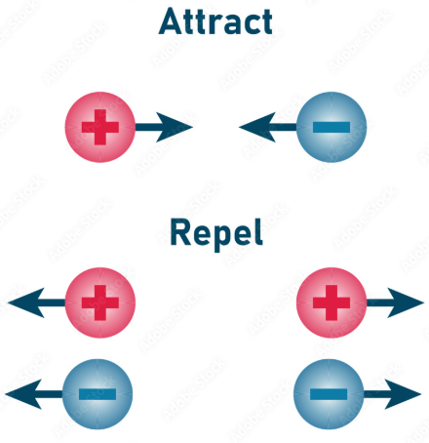
The Law of Charges: Coulomb's Law
The fundamental rule of how charges interact is simple and universal:
Opposite Charges ATTRACT
  A positive charge and a negative charge will pull toward each other.
Like Charges REPEL
  Two positive charges will push away from each other.
  Two negative charges will also push away from each other.
  This law of attraction and repulsion is the force that makes electrons move.

Slide 17
Materials & Electron Flow
Based on what we've learned about valence electrons and Coulomb's Law, we can now classify materials based on how easily they allow electrons to move.
There are three main categories:
Conductors
Insulators
Semiconductors

Slide 18
Conductors
Definition: Materials that allow electric charge (electrons) to flow through them easily.
Atomic Structure: They have 1 to 3 valence electrons that are loosely held by the nucleus.
These "free electrons" can be easily pushed from one atom to the next.
Examples:
Best: Silver, Copper, Gold, Aluminum
Good: Brass, Steel, most other metals.
Copper is the most common conductor used in electrical wiring because it offers a great balance of conductivity and cost.

Slide 19
Insulators
Definition: Materials that resist or prevent the flow of electric charge.
Atomic Structure: They have 5 to 8 valence electrons. Their valence shell is full or nearly full.
Electrons are held very tightly to the nucleus and are not free to move.
Examples:
Rubber
Plastic
Glass
Porcelain
Dry Wood
Air
Insulators are essential for safety, used to cover wires and protect us from electric shock.

Slide 20
Semiconductors
Definition: Materials that are neither good conductors nor good insulators.
Atomic Structure: They have exactly 4 valence electrons.
Their properties can be precisely controlled by adding impurities (a process called "doping").
Examples:
Silicon (Si)
Germanium (Ge)
Semiconductors are the foundation of all modern electronics: diodes, transistors, computer chips, solar panels, etc.

Slide 21
Summary Table
Property | Conductors | Insulators | Semiconductors
Valence Electrons | 1-3 (Few) | 5-8 (Many) | 4 (Exactly)
Electron Mobility | Very High (Free) | Very Low (Bound) | Can be controlled
Resistance to Flow | Very Low | Very High | Moderate
Purpose | To allow current flow | To block current flow | To control current flow
Example | Copper Wire | Rubber Sheath | Computer Chip

Slide 22
Module 1 Recap
All matter is made of atoms.
Atoms contain protons (+), neutrons, and electrons (-).
The valence shell is the key to electrical properties.
Conductors have few valence electrons and let current flow easily.
Insulators have many valence electrons and block current flow.
Semiconductors have 4 valence electrons and are used to control flow.
The law of charges states that opposites attract and likes repel.

Slide 23
Module 2: Electrical Quantities
Session 2.1: EMF and Electric Current

Slide 24
The "Big Three" of Electricity
To understand any electrical circuit, you must know these three key quantities:
Voltage (V): The electrical pressure or "push."
Current (I): The rate of electrical flow.
Resistance (R): The opposition to flow.
We will use a simple water pipe analogy to understand how they relate to each other.

Slide 25
Electromotive Force (EMF) / Voltage
Definition: Electromotive Force (EMF), more commonly called Voltage, is the potential difference or pressure that causes electrons to move in a circuit.
It's the "push" that forces electrons away from a negative point and towards a positive one.
Unit of Measurement: The Volt (V).
Without voltage, there is no push, and therefore no current can flow.

Slide 26
Water Analogy: Voltage is Pressure
High Voltage is like a full water tower. It creates a lot of pressure, with the potential to push a large amount of water.
Low Voltage is like a nearly empty water tower. There is very little pressure, so it can only push a small amount of water.

Slide 27
Where Does Voltage Come From? Sources of EMF
Voltage is created by converting other forms of energy into electrical energy.
1. Chemical Source: Cells & Batteries
How it works: A chemical reaction inside the cell creates a buildup of electrons at the negative terminal (-) and a shortage at the positive terminal (+), resulting in a voltage.
Primary Cells: Non-rechargeable (e.g., standard AA, AAA batteries).
Secondary Cells: Rechargeable (e.g., car batteries, phone batteries).

Slide 28
Sources of EMF (Continued)
2. Magnetic Source: Generators
How it works: Based on the principle of electromagnetic induction. When a wire is moved through a magnetic field, a voltage is "induced" in the wire. This is how almost all the world's electricity is generated.
3. Other Sources
Thermal (Thermocouples): Heating a junction of two different metals creates a small voltage. Used for temperature sensors.
Light (Photovoltaic Cells): Light striking a semiconductor material (like silicon) knocks electrons free, creating a voltage. This is how solar panels work.

Slide 29
Electric Current
Definition: Electric Current is the rate of flow of electric charge through a conductor. It's the measure of how many electrons are moving past a point in a certain amount of time.
Unit of Measurement: The Ampere (A), often just called "Amps".
The symbol for current in formulas is I (from the French intensité du courant).
Current is what does the work in a circuit (e.g., lights a lamp, turns a motor).

Slide 30
Water Analogy: Current is Flow Rate
High Current is like a wide pipe with lots of water flowing through it (many litres per second).
Low Current is like a narrow pipe with only a trickle of water flowing through it (few litres per second).

Slide 31
The Relationship Between Current and Charge
Remember that charge (Q) is measured in Coulombs, and Current (I) is measured in Amps.
1 Ampere is defined as 1 Coulomb of charge flowing past a point in 1 second.
This gives us a very useful formula: Q = I x t
Q = Quantity of Charge (in Coulombs)
I = Current (in Amps)
t = time (in seconds)

Slide 32
Calculation Practice
Question 1: A current of 5 Amps flows through a lamp for 2 minutes. What quantity of electricity (charge) is transferred?
Step 1: Convert time to seconds. 2 minutes x 60 = 120 seconds.
Step 2: Use the formula Q = I x t.
Step 3: Q = 5 A x 120 s
Answer: Q = 600 C
Question 2: If 540 Coulombs of charge passes through a point in 2 minutes, what is the current?
Step 1: Rearrange the formula: I = Q / t
Step 2: Time in seconds = 2 x 60 = 120 s
Step 3: I = 540 C / 120 s
Answer: I = 4.5 A

Slide 33
Module 2: Electrical Quantities
Session 2.2: Resistance & Current Flow

Slide 34
Conventional vs. Electron Flow
The Big Question: Which way does electricity actually flow?
This is one of the most confusing topics for new apprentices, but it's simple once you understand the history. There are two "correct" answers:
Electron Flow: What is physically happening.
Conventional Flow: The standard used on all drawings and for all calculations.
You MUST understand both.

Slide 35
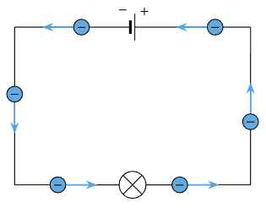
Electron Flow Theory (The Physical Reality)
We know that electrons are negatively charged particles.
The negative terminal of a battery has a surplus of electrons.
The positive terminal has a shortage of electrons.
Based on the Law of Charges (opposites attract, likes repel), electrons are repelled from the negative terminal and attracted to the positive terminal.
Therefore, electrons physically flow from NEGATIVE (-) to POSITIVE (+).

Slide 36
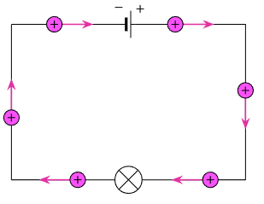
Conventional Current Theory (The Industry Standard)
Early scientists, like Benjamin Franklin, studied electricity before the electron was discovered.
They assumed that electricity was the flow of some kind of positive fluid.
Therefore, they established the convention that current flows from a point of high potential (+) to a point of low potential (-).
By the time the electron was discovered, this convention was already the standard for all diagrams and formulas worldwide. It was too late to change.
Therefore, for all electrical work, we assume current flows from POSITIVE (+) to NEGATIVE (-).

Slide 37
Seeing Both Flows
Rule of Thumb:
When you are thinking about physics and what is actually happening, think Electron Flow.
When you are looking at a schematic, drawing a circuit, or doing calculations, you MUST use Conventional Flow.

Slide 38
Resistance
Definition: Resistance is the opposition to the flow of electric current.
It's a measure of how difficult it is for electrons to pass through a material.
Resistance converts electrical energy into heat energy.
Unit of Measurement: The Ohm.
Symbol: The Greek letter Omega (Ω).

Slide 39
Water Analogy: Resistance is Obstruction
Low Resistance is like a wide, clear pipe. Water flows through it easily.
High Resistance is like a narrow, rusty, or blocked pipe. It's very difficult to push water through it.

Slide 40
Four Factors Affecting Resistance
The resistance of a conductor depends on four key factors:
Length
Cross-Sectional Area (Thickness)
Material Type (Resistivity)
Temperature
Let's look at each one.

Slide 41
Factor 1: Length
The longer a conductor, the higher its resistance.
Analogy: It's harder to push water through a very long hose than a short one because of the increased friction.
Reason: A longer wire means the electrons have to travel past more atoms, and each collision with an atom causes opposition.
Resistance is directly proportional to length. (If you double the length, you double the resistance).

Slide 42
Factor 2: Cross-Sectional Area (C.S.A)
The thicker a conductor, the lower its resistance.
Analogy: A wide fire hose has less resistance to water flow than a narrow garden hose.
Reason: A thicker wire provides more available paths for the electrons to flow through.
Resistance is inversely proportional to cross-sectional area. (If you double the area, you halve the resistance).

Slide 43
Factor 3: Material Type (Resistivity)
Every material has its own natural, built-in opposition to current flow. This property is called resistivity.
As we learned in Module 1, conductors have very low resistivity.
Insulators have very high resistivity.
Example Resistivity (at 20°C):
Copper: 1.68 x10⁻⁸ Ω·m (very low)
Glass: 10¹⁰ to 10¹⁴ Ω·m (extremely high)

Slide 44
Factor 4: Temperature
For most conductors, as temperature increases, resistance increases.
Reason: Heating a material causes its atoms to vibrate more rapidly. This makes it more difficult for electrons to find a clear path through, leading to more collisions and higher resistance.
Note: This is not true for all materials. Semiconductors, for example, typically decrease their resistance as they get hotter.

Slide 45
Module 2 Recap
Voltage (V) is the pressure that pushes current. Measured in Volts.
Current (I) is the rate of flow. Measured in Amps.
Resistance (R) is the opposition to flow. Measured in Ohms (Ω).
Conventional Flow (+ to -) is the standard used for all circuit analysis.
Resistance is affected by a conductor's length, thickness, material type, and temperature.

Slide 46
Module 3: Ohm's Law & Circuit Analysis
Session 3.1: The Simple Circuit & Ohm's Law

Slide 47
The Electric Circuit
For electricity to do useful work, we need a complete circuit. A circuit is simply a closed loop or path that allows current to flow.
Every useful circuit has four essential parts:
Source: Provides the voltage (EMF). (e.g., a battery)
Path: The conductors that carry the current. (e.g., copper wires)
Load: The device that uses the electricity and provides resistance. (e.g., a lamp)
Control: A device to open or close the circuit. (e.g., a switch)

Slide 48
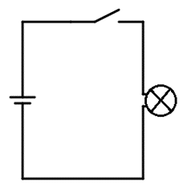
A Simple Circuit Diagram
Here are the four parts working together:
When the Control (switch) is closed, the loop is complete, and current flows from the Source, through the Path, to the Load, and back to the source.

Slide 49
Open Circuits
An Open Circuit is a circuit where the path has been broken.
This could be due to an open switch, a broken wire, or a blown fuse.
Because the loop is incomplete, no current can flow.
An open circuit has infinite resistance.

Slide 50
Short Circuits
A Short Circuit is an unintended, low-resistance path for current to flow.
It allows current to bypass the load.
Because there is almost no resistance, Ohm's Law (I = V/R) tells us the current will become dangerously high.
DANGER: Short circuits can cause wires to overheat, melt, and start fires. They are a major electrical hazard. Fuses and circuit breakers are designed to protect against this.

Slide 51
Graphical Symbols
Instead of drawing pictures of components, electricians use a standard set of graphical symbols to draw circuit diagrams (schematics).
Learning these symbols is like learning the alphabet of electricity.
We will now learn the most common symbols. You will be given a full chart for your reference.

Slide 52
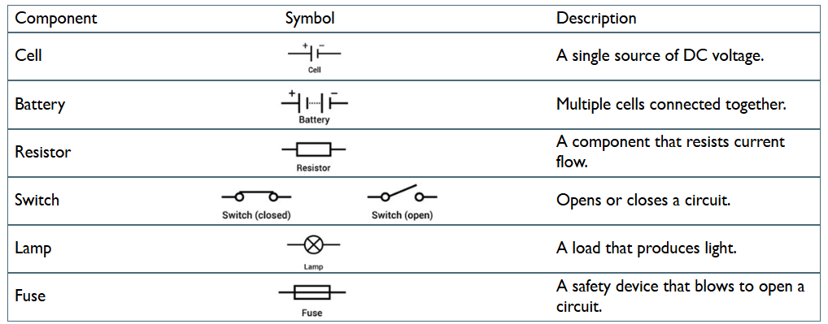
Common Component Symbols

Slide 53
Meter Symbols & Connection
Meters must be connected correctly to measure properly.
Ammeter (Measures Current)
  Symbol: --(A)--
  Must be connected IN SERIES with the load (so all the current flows through it).
Voltmeter (Measures Voltage)
  Symbol: --(V)--
  Must be connected IN PARALLEL with the load (across the component).
Ohmmeter (Measures Resistance)
  Symbol: --(Ω)--
  Must only be used when the circuit is DE-ENERGIZED (power off).

Slide 54
How ELECTRICITY works - working principle
https://www.youtube.com/@EngineeringMindset

Slide 55
Module 3: Ohm's Law & Circuit Analysis
Session 3.2: Ohm's Law Calculations & Prefixes

Slide 56
Ohm's Law
Definition: Ohm's Law describes the relationship between voltage, current, and resistance. It states:
"The current flowing through a conductor is directly proportional to the voltage across it and inversely proportional to the resistance, provided all physical conditions and temperature remain constant."
In simple terms:
If you increase the voltage (push), the current (flow) will increase.
If you increase the resistance (opposition), the current (flow) will decrease.

Slide 57
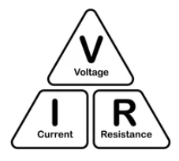
The Ohm's Law Formula
The relationship is expressed by the formula:
V = I x R
V = Voltage (in Volts)
I = Current (in Amps)
R = Resistance (in Ohms)
You can use the Ohm's Law Triangle to easily rearrange the formula to solve for any of the three variables.
To find V: Cover V, which leaves I x R.
To find I: Cover I, which leaves V / R.
To find R: Cover R, which leaves V / I.

Slide 58
Calculation Practice
Let's use the formula.
Example 1: A simple circuit has a 230Ω resistor connected to a power source. If a current of 5 Amps is flowing, what is the source voltage?
Known: R = 230Ω, I = 5A
Unknown: V
Formula: V = I x R
Calculation: V = 5A x 230Ω
Answer: V = 1150 Volts

Slide 59
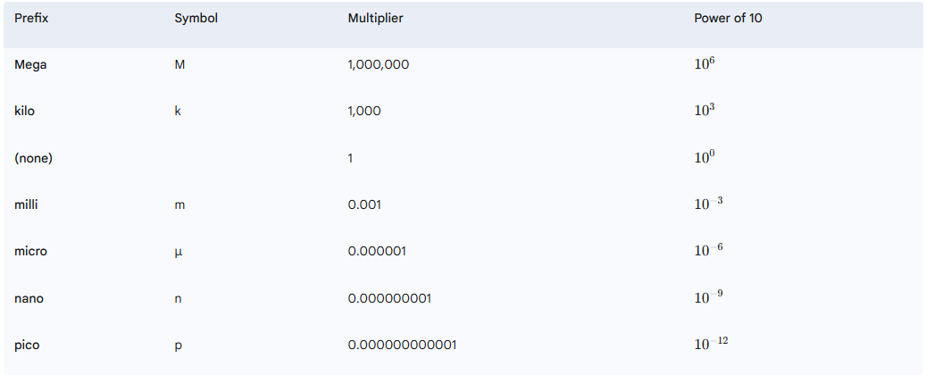
Working with Large & Small Numbers
In electrical / electronics, we often work with very large or very small numbers. We use engineering prefixes to make them easier to write.
IMPORTANT: You must convert all values to their base units (Volts, Amps, Ohms) before doing calculations!

Slide 60
Calculation with Prefixes
Example 2: A circuit has a resistance of 2 kΩ and a current of 50 mA is flowing. What is the voltage?
Step 1: Convert to base units.
  R = 2 kΩ = 2 x 1000 = 2000 Ω
  I = 50 mA = 50 / 1000 = 0.05 A
Step 2: Use the formula.
  V = I x R
  V = 0.05 A x 2000 Ω
Answer: V = 100 Volts

Slide 61
Ohms Law Explained - The basics circuit theory https://www.youtube.com/@EngineeringMindset

Slide 62
Worksheet Activity
Now it's your turn to practice.
Please take a worksheet and complete the Ohm's Law problems.
Remember to show your work.
Write down the formula you are using.
Convert all prefixes to base units before calculating.
Don't forget the units in your final answer!

Slide 63
Module 3 Recap
A circuit needs a Source, Path, Load, and Control to work.
Open circuits have no current flow, while short circuits have dangerously high current flow.
Graphical symbols are the language of electrical diagrams.
Ohm's Law (V = I x R) is the fundamental formula that connects voltage, current, and resistance.
Always convert prefixes to base units (Volts, Amps, Ohms) before calculating.

Slide 64
Module 4: Practical Application, Safety & Assessment
Session 4.1: Practical Lab & Effects of Current

Slide 65
Lab Prep & Multimeter Use
Safety First!
This is a low-voltage lab, but good safety habits start now.
Always handle equipment carefully.
Wear safety glasses.
Keep your workspace tidy.
If you are unsure about something, ASK!
The Digital Multimeter (DMM)
This is your most important tool for electrical measurements.
We will use it to measure Voltage (V), Current (A), and Resistance (Ω).
Crucial Rule: The way you connect the meter depends on what you are measuring.

Slide 66
Connecting Your Meters
Measuring Voltage (IN PARALLEL)
The voltmeter is connected across the component to measure the pressure difference between two points.
Measuring Current (IN SERIES)
The ammeter must be connected in line with the components, so the current has to flow through the meter to be measured. You have to break the circuit to insert the ammeter.
Measuring Resistance (POWER OFF)
The ohmmeter provides its own small voltage. NEVER use it on a circuit with the power on. You must remove the component from the circuit to get an accurate reading.

Slide 67
Practical Lab: Verifying Ohm's Law
To build a simple circuit and prove that our measured values for V, I, and R match the Ohm's Law formula (V = I x R).
Procedure (per group):
Measure Resistance: With the power OFF, use the DMM to measure the exact resistance of your resistor. Record this value.
Build the Circuit: On your breadboard, build a simple circuit with the power supply and the resistor.
Set Voltage: Turn the power supply on and set it to 5 Volts.
Measure Voltage: Connect the voltmeter in parallel with the resistor and record the exact voltage.
Measure Current: Turn the power OFF. Break the circuit and connect the ammeter in series. Turn the power back ON and record the current.
Calculate: Use your measured V and I to calculate resistance (R = V / I).
Verify: Compare your calculated resistance to the resistance you measured in Step 1. They should be very close!

Slide 68
Effects of Current
As current flows through a circuit, it produces other effects. We can observe some of these in our lab.
Heating Effect
  As electrons flow through the resistor, their collisions with atoms generate heat.
  Observation: Carefully touch your resistor. You may feel it get slightly warm. This effect is used in toasters, electric heaters, and fuses.
Magnetic Effect
  Every electric current generates a magnetic field around the conductor. This is the principle behind motors, generators, and transformers.
Chemical Effect
  Current can cause chemical reactions. This is the principle of batteries (charging/discharging) and electroplating.

Slide 69
Module 4: Practical Application, Safety & Assessment
Session 4.2: Electrical Safety

Slide 70
Electrical Safety: Your #1 Priority
This is the most important session of the entire course.
Understanding the theory is great, but working safely ensures you have a long and successful career.
Electricity is invisible and gives no warning. Respect it, always.
"There are old electricians and there are bold electricians, but there are no old, bold electricians."

Slide 71
The Human Body & Electricity
Why is electricity dangerous? Because the human body is a conductor.
Our nervous system works using tiny electrical signals. External current can override these signals with disastrous results.
Effects of Current (AC) on the Body:
1 mA: Can just be felt (perception level).
5 mA: Shock is painful.
10-20 mA: Muscle contractions begin. Victim may not be able to let go ("let-go" threshold).
50-100 mA: Ventricular Fibrillation. The heart's rhythm is disrupted. This is often fatal.
> 200 mA: Severe burns and cardiac arrest.
It takes very little current to kill.

Slide 72
Main Electrical Hazards
Electric Shock: Current passing through the body. The path the current takes is critical (e.g., hand-to-hand across the heart is most dangerous).
Burns: Caused by current flowing through and heating body tissue, or by contact with overheated electrical components.
Arc Flash / Arc Blast: An explosive release of energy from a high-amperage short circuit (e.g., dropping a metal tool in a live panel). Can cause fatal burns, pressure waves, and flying shrapnel.
Fire: Caused by overloaded circuits, faulty wiring, or short circuits igniting flammable materials.

Slide 73
Basic Safety Rules
ALWAYS assume a circuit is live until you have proven it is dead.
Use a known, working voltage tester to test for the absence of voltage.
Lockout/Tagout (LOTO): De-energize and lock the power source before working on equipment. This is a life-saving procedure.
Use insulated tools and wear appropriate Personal Protective Equipment (PPE).
Never work on live equipment unless absolutely necessary and properly trained.
Keep your work area clean and dry.

Slide 74
Key Takeaways:
Respect all voltages.
A tiny amount of current can be fatal.
Test Before You Touch.
Lockout/Tagout saves lives.

Slide 75
Module 4: Practical Application, Safety & Assessment
Session 4.3: Final Review & Assessment

Slide 76
Comprehensive Review
Let's recap the entire course:
Module 1: We learned about the atom, valence electrons, and how they determine if a material is a conductor or insulator.
Module 2: We defined Voltage (V), Current (I), and Resistance (R), and learned the difference between Conventional and Electron Flow.
Module 3: We defined the parts of a circuit, learned graphical symbols, and mastered the Ohm's Law formula (V=IR), including calculations with prefixes.
Module 4: We verified Ohm's Law in the lab and covered the critical principles of electrical safety.

Slide 77
Summative Assessment
Now it's time to put your knowledge to the test.
You will now be given the assessment sheets.
Please read each question carefully.
Show your calculations where required.
This assessment covers all the key learning outcomes of the course.

